Slide 1
Integrating Strategic Planning and Performance Management
February 28, 2018

Slide 2
Florida Department of Environmental Protection
Welcome
Ashley Willard, MBA, Business Consultant
Florida Department of Environmental Protection
Office of the Secretary,
Office of Strategic Initiatives and Development

Slide 3
Florida Department of Environmental Protection
AGENDA
About DEP
DEP’s Strategic Planning Journey
Tracking and Reporting
Year One
Our Struggles
The Future

Slide 4
Florida Department of Environmental Protection
DEP
The Florida Department of Environmental Protection is the state’s lead agency for environmental management and stewardship, protecting our air, water and land. DEP is divided into three primary areas:
Land and Recreation
Regulatory programs
Ecosystem Restoration programs
Over 4,000 employees across Florida

Slide 5
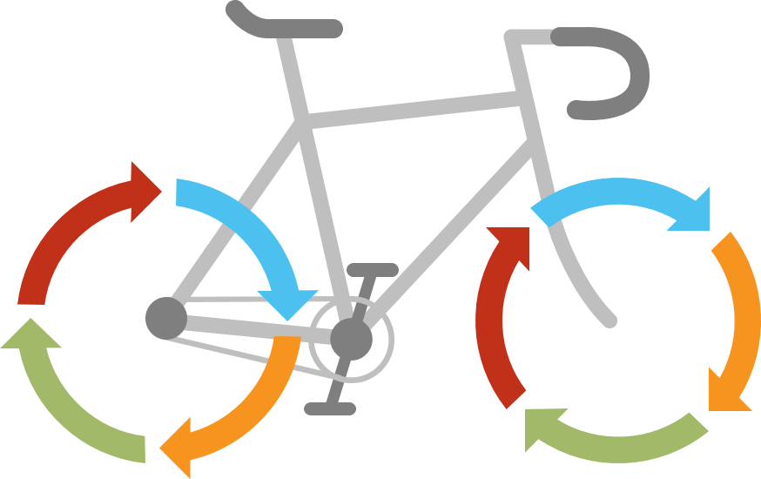
Florida Department of Environmental Protection
Struggling with developing measures
How to measure success
Develop a Strategy Map
Leadership engagement
Steering Committee
Strategic measures
Hiring a facilitator

Slide 6
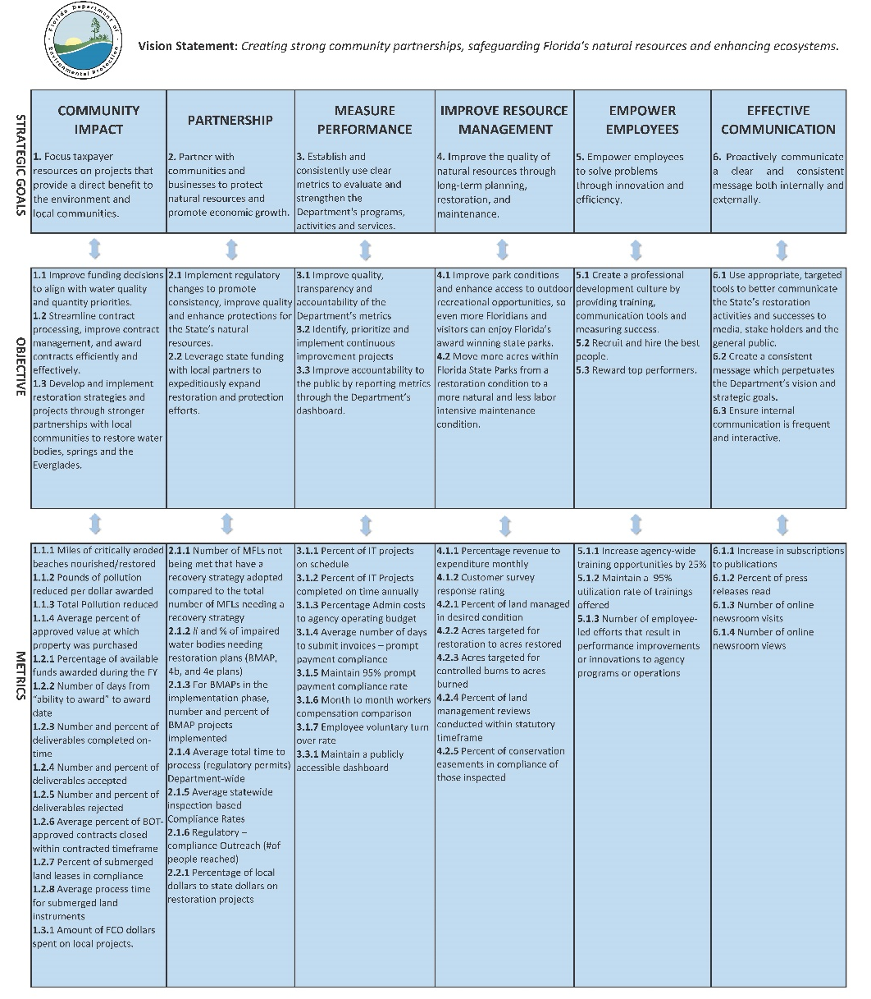
Florida Department of Environmental Protection
Strategy Map

Slide 7
Florida Department of Environmental Protection
Tracking and Reporting
Used Excel
Multiple people
Using multiple spreadsheets
Saved in multiple locations
Time consuming
Manual aggregation
We needed a solution!

Slide 8
Florida Department of Environmental Protection
Search for a Solution
Determine your needs.
DEP needed a tool to help collect data and visual report the data.
The tool should be:
Easy to setup with little technical support required.
Easy to use and intuitive.
Affordable.
Conduct research and request demos.

Slide 9
Florida Department of Environmental Protection
Year One
Planning for Phase II
01
03
05
02
04
Learning curve
Meaningful metrics
Initiatives
Division level metrics
Project tracking

Slide 10
Florida Department of Environmental Protection
The Data Struggle
Large datasets
ClearPoint Data Loader
Data cleanup and standardization
Data not shared
Feelings of ownership

Slide 11
Florida Department of Environmental Protection
New Leadership
Additional priorities
Fine-tuning messaging and communications
Clarifying key performance questions
Identifying data gaps
Improving technical tools to support data management and presentation

Slide 12
Florida Department of Environmental Protection
The Future
Salesforce integration
Data analytic tools
Connecting events and Communications reporting
Enterprise-wide tracking of campaigns
Shared data, views, and dashboards

Slide 13
Florida Department of Environmental Protection
Adaptability
of
ClearPoint
Allowed for the development of a Performance Reporting System
Will easily link to other dynamic technology
Will support enterprise project management through Initiatives functions

Slide 14
Florida Department of Environmental Protection
“Persistence is what makes the impossible possible, the possible likely, and the likely definite.”
-Robert Half
Questions or comments?
Ashley.Willard@dep.state.fl.us
850.245.2208

